Slide 1
Dof3aa
educational file management system

Slide 2
Team
- Mostafa Ahmed Hassan El-Gelany
- Mohamed Badawy Sayed
- Mahmoud Ahmed Khalil
- Ahmed Nageh Abbas

Slide 3





What Is The Problem ?
- There is no unified source for materials .

Slide 4
What Is The Main Problem ?
^{- Distraction:}
- There is no main source for information.
- There is no main source for communication.

Slide 5
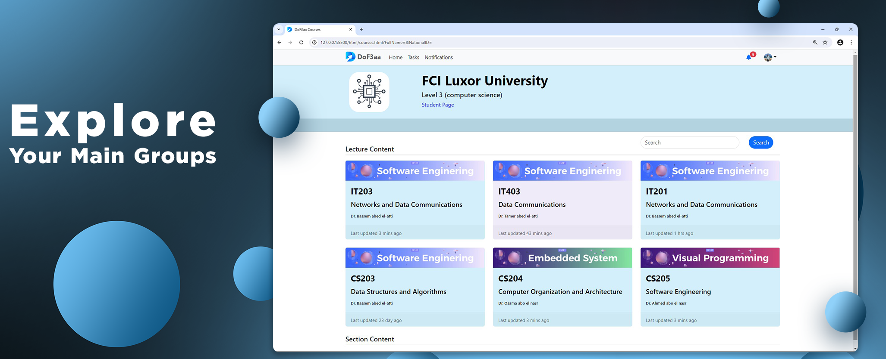
Website

Slide 6
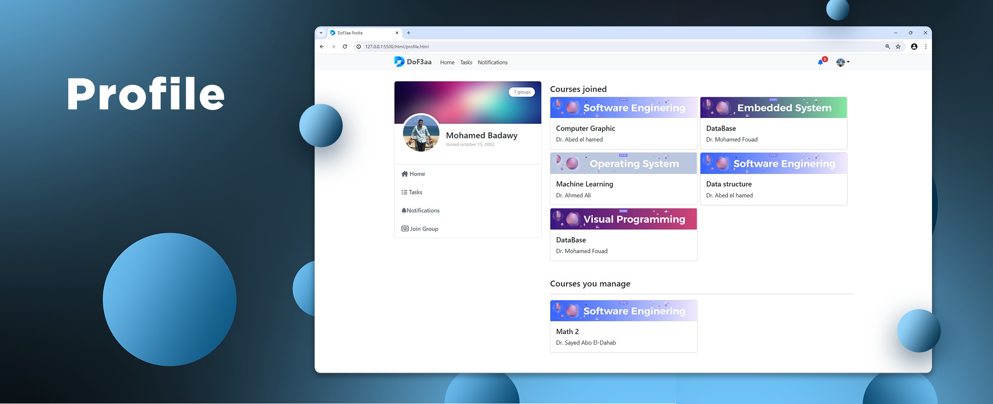
Website

Slide 7
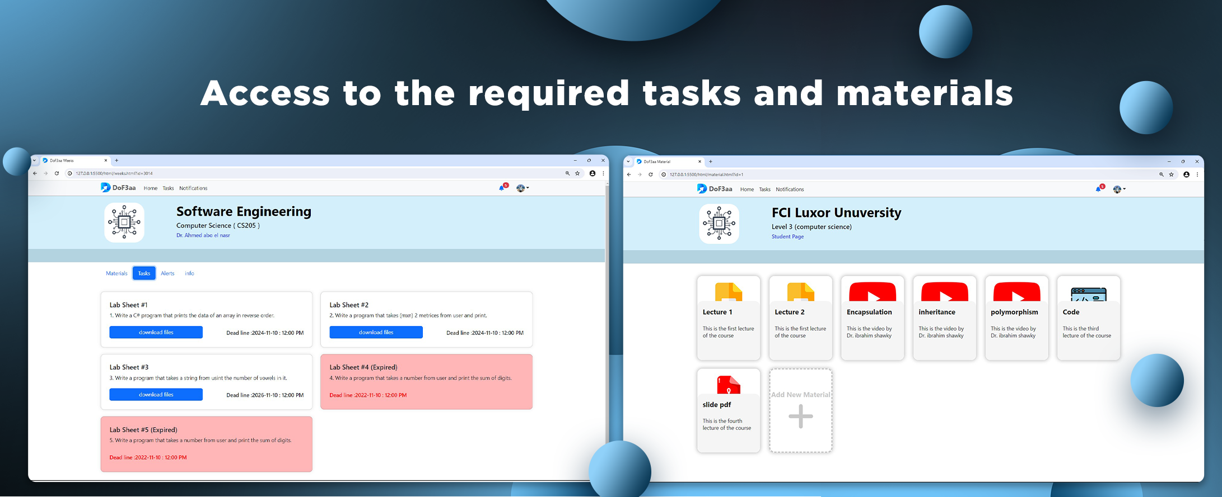
Website

Slide 8
Main Project Goals
Dof3aa is a web application designed to foster a cohesive and organized community among faculty’s students. It serves as a central hub for all faculty-related updates, materials, and assignments, ensuring that students remain fully informed and engaged with their academic environment.
This comprehensive documentation offers a detailed insight into the system, covering its scope, requirements, dependencies, and architecture.

Slide 9
Scope
The dof3aa Web Application will include features for both admins and students. Admins will be able to create and manage courses, upload course materials, and add announcements. Students will be able to enroll in courses, and access course materials, announcements, and tasks.

Slide 10
Functional requirements
User Registration & Login: Users can register for an account and log in. The login process is secured, ensuring that user credentials are protected.
Role Differentiation: The system distinguishes between two primary roles: Admin and Student. Each role has unique permissions and access rights within the system.
Course Management: Users have the ability to create new courses within the system or delete courses.
Content Management: Admins can upload, update, and remove course materials as needed.

Slide 11
Functional requirements
Announcements: Admins have the authority to create, edit, and delete announcements for courses.
Role Assignment: Admins can change the roles of users, promoting member to admins or demoting admins to membber, as necessary.
Assignment Management: Admins can create, modify, and delete assignments within courses and add deadlines to tasks.

Slide 12
Functional requirements
Course Enrollment: Students can enroll in available courses of their interest.
Resource Access: Students have the ability to browse through course materials, announcements, and assignments.
Material Downloads: Students can download course materials for offline study.
Course Withdrawal: Students have the option to unenroll from courses if they choose.

Slide 13
Non-Functional requirements
Security:
Data Encryption: All personal information and user credentials must be securely encrypted to protect against unauthorized access.
Access Control: Implement strict access control measures to ensure that only authenticated students can access their respective courses, materials, and announcements.

Slide 14
Non-Functional requirements
Performance:
Quick Load Times: The platform should load content and respond to user requests within 2 seconds under typical usage conditions.
Scalability: Capable of scaling dynamically to accommodate increases in user numbers and data volume, supporting at least 10,000 simultaneous student logins.

Slide 15
Non-Functional requirements
Usability:
Intuitive Design: The platform must feature an intuitive, straightforward design enabling students to find and use features without extensive guidance.
Support Resources: Provide detailed help documentation and resources, allowing students to resolve common issues independently and understand platform functionalities.

Slide 16
Non-Functional requirements
Reliability:
High Availability: Achieve 99.9% uptime, not including planned maintenance windows, to ensure students can always access their materials and announcements.
Consistent Data Integrity: Employ mechanisms to ensure that uploaded materials and entered data are consistently validated, preventing errors or corruption.
Robust Backup and Recovery: Regularly back up data with a reliable recovery strategy in place to quickly restore service in case of system failure or data loss.

Slide 17
Non-Functional requirements
Maintainability:
Modular Architecture: Design the system with a modular approach to simplify updates, maintenance, and the rollout of new features.
Comprehensive Documentation: Maintain detailed documentation of the system’s architecture, codebase, and APIs to facilitate efficient maintenance and future enhancements.
Future-proof Technologies: Choose widely supported and contemporary technologies for development to ensure long-term viability and community support.

Slide 18
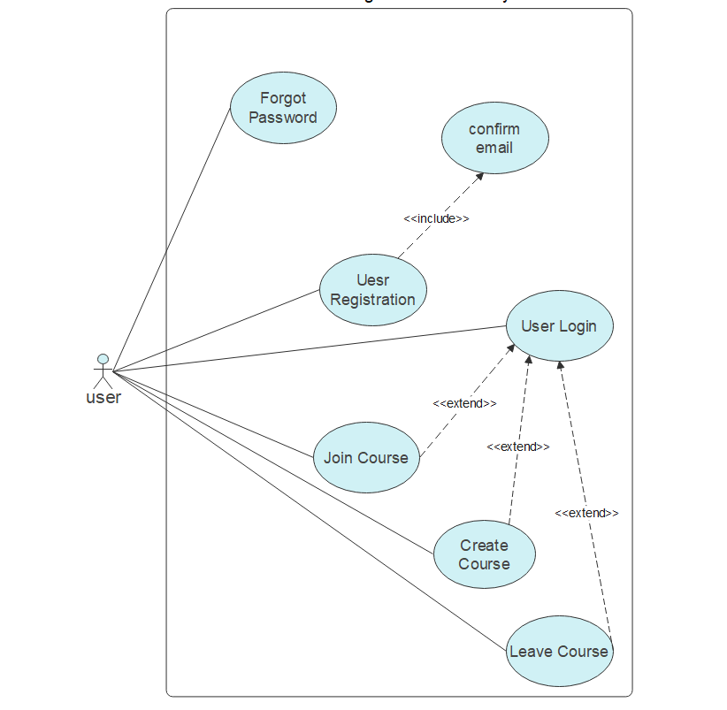
Use Case Diagram

Slide 19
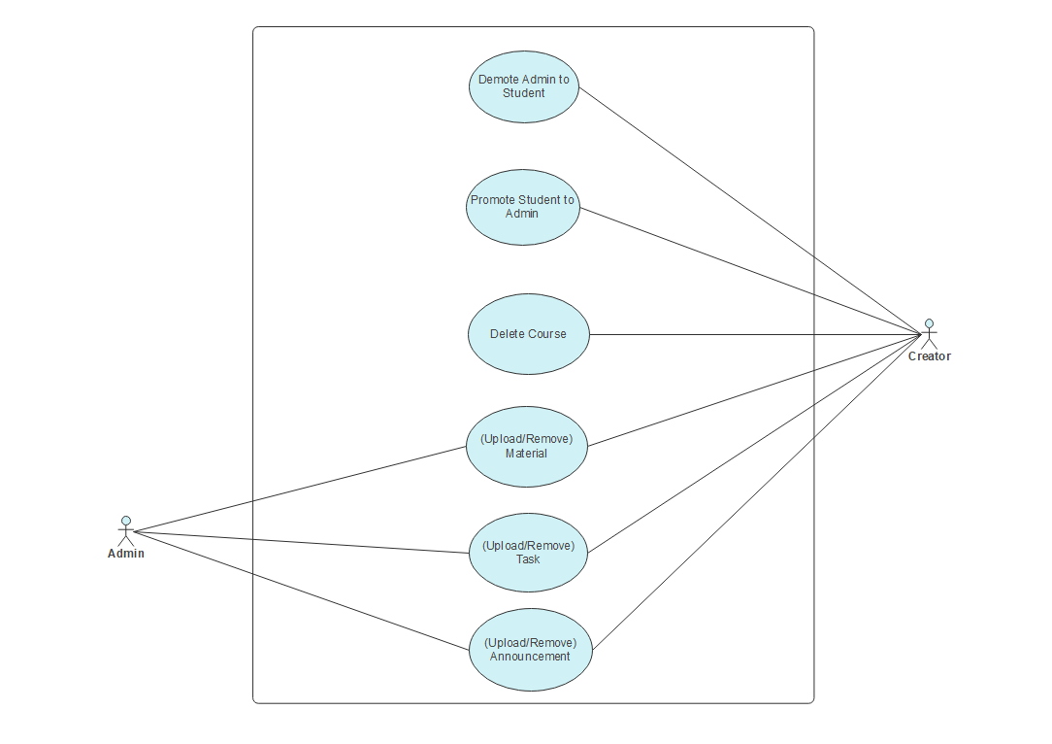
Use Case Diagram

Slide 20
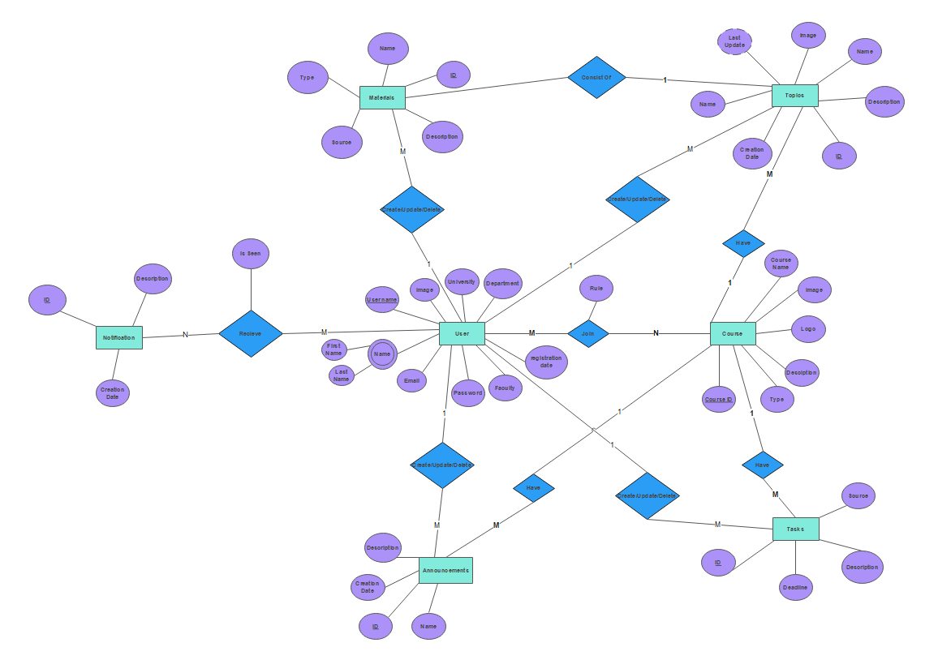
Entity Relationship Diagram

Slide 21
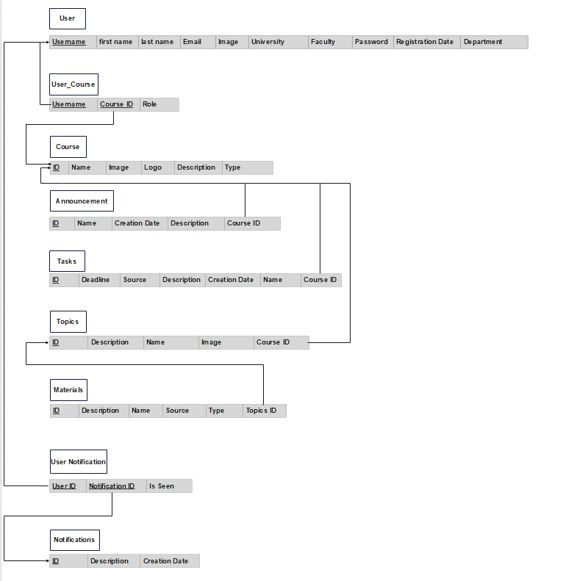
Schema

Slide 22
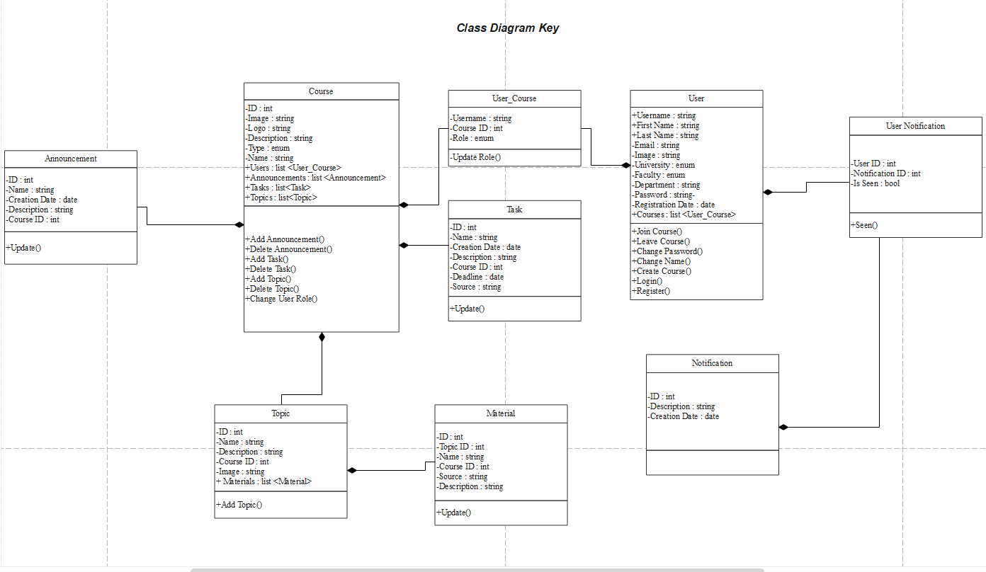
Class Diagram

Slide 23
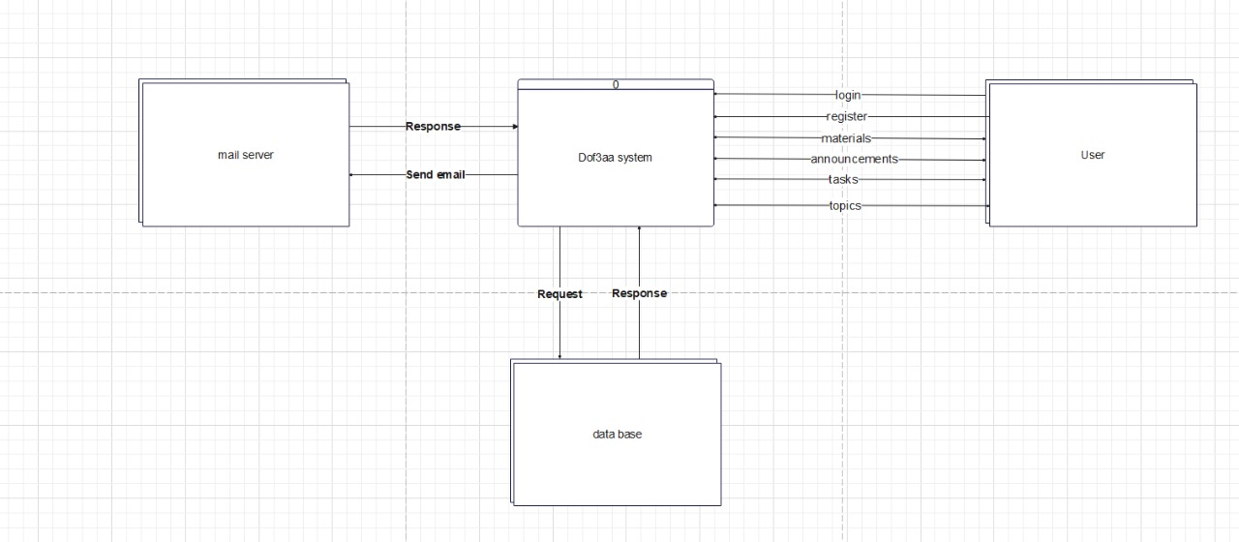
Context Diagram

Slide 24
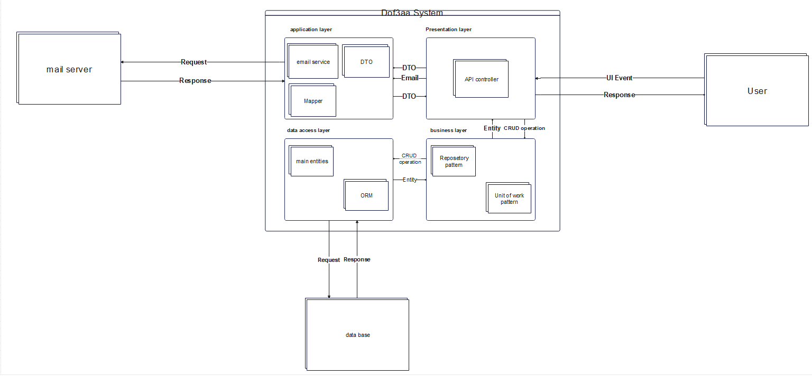
Architecture Design

Slide 25
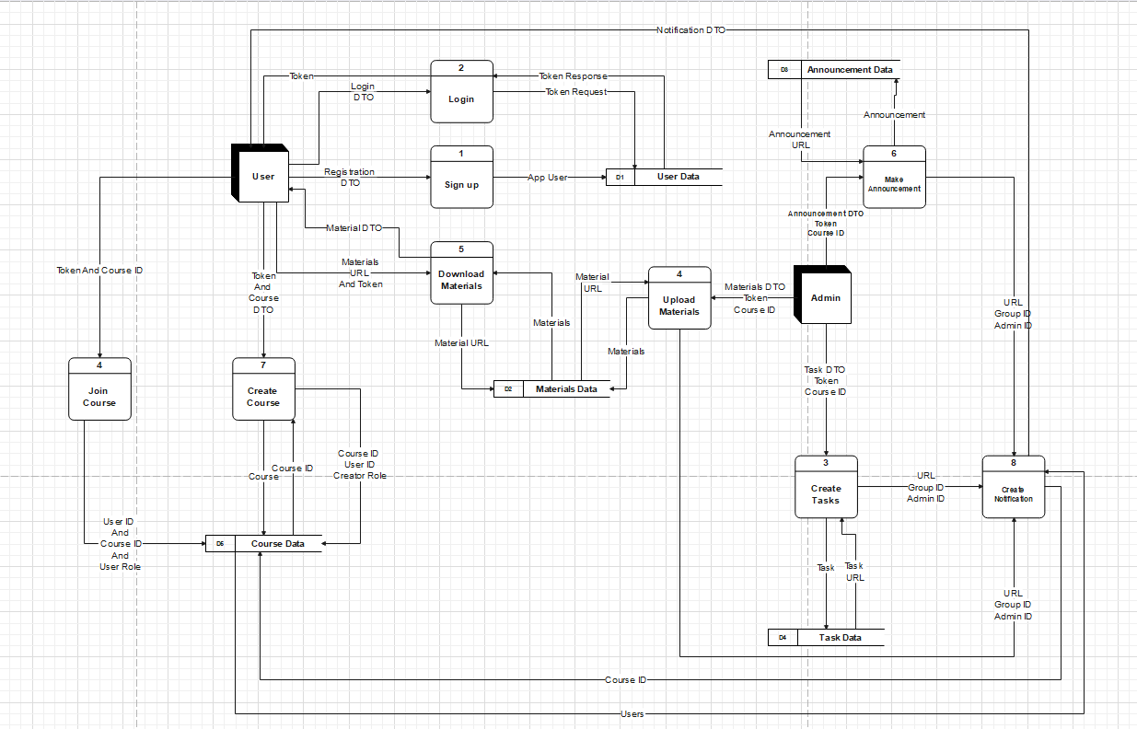
Data Flow Diagram

Slide 26
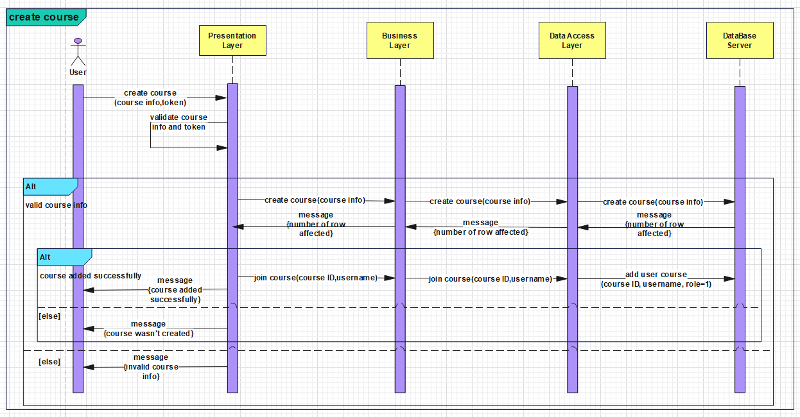
Sequence Diagram

Slide 27
Thank You

